Slide 1
Module 3: Supplementary Slides (These additional materials are optional and intended for students who are interested)

Slide 2
Vectors
More Vector Arithmetic
m%%n Modulo operator (gives the remainder of m/n)
%/% Integer division (gives the integer part of m/n)
%*% Matrix multiplication (to be studied later)
%in% Returns TRUE if the left operand occurs in its right operand; FALSE otherwise
> 14%%5
[1] 4
> 14%%5
[1] 2
> 5%in%14
[1] FALSE
> 5%in%c(5,4)
[1] TRUE

Slide 3
General Norm of a Vector

Slide 4
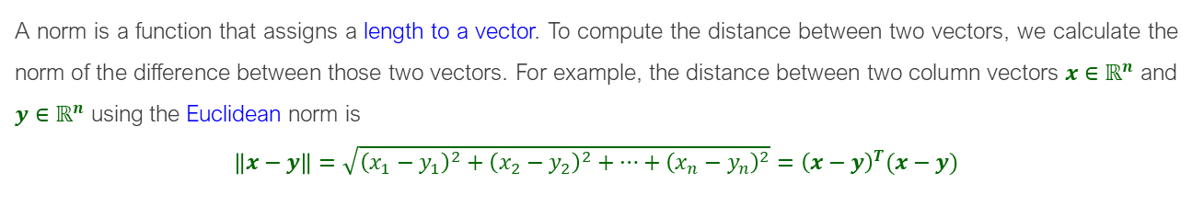
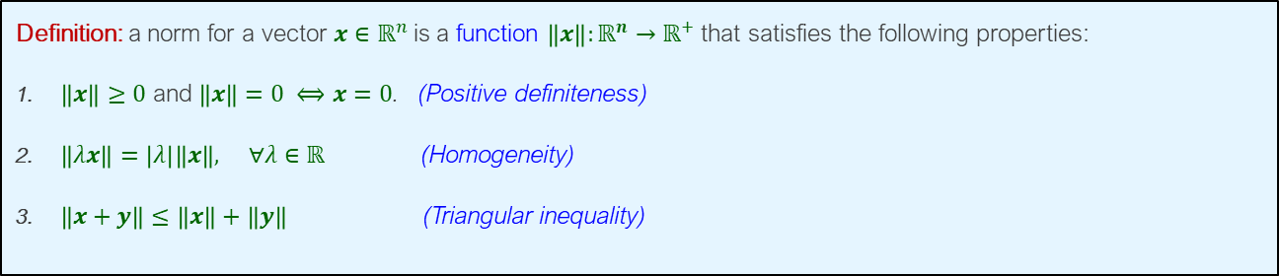
Norm of a Vector
Definition: a norm for a vector $x∈ℝ^{n}$is a function $\left\|x\right\|:ℝ^{n}→ℝ^{+}$ that satisfies the following properties:
$\left\|x\right\|≥0$ and $\left\|x\right\|=0 ⟺x=0$. (Positive definiteness)
$\left\|λx\right\|=\left|λ\right|\left\|x\right\|, ∀λ∈ℝ$ (Homogeneity)
$\left\|x+y\right\|≤\left\|x\right\|+\left\|y\right\|$ (Triangular inequality)
A norm is a function that assigns a length to a vector. To compute the distance between two vectors, we calculate the norm of the difference between those two vectors. For example, the distance between two column vectors $x∈ℝ^{n}$ and $y∈ℝ^{n}$ using the Euclidean norm is
$$\left\|x−y\right\|=\sqrt{{\left(x_{1}−y_{1}\right)}^{2}+{\left(x_{2}−y_{2}\right)}^{2}+…+{\left(x_{n}−y_{n}\right)}^{2}}={\left(x−y\right)}^{T}(x−y)$$

Slide 5

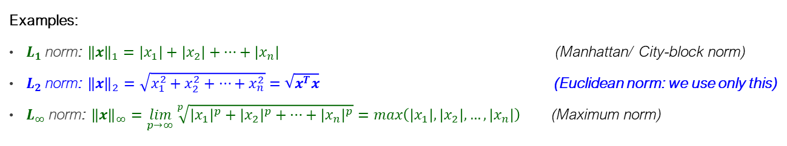
Common Norms
$L_{p}$ norm is a family of commonly used norms for vectors $x∈ℝ^{n}$ that are determined by a scalar $p≥1$ as:
$${\left\|x\right\|}_{p}=\sqrt[p]{{\left|x_{1}\right|}^{p}+{\left|x_{2}\right|}^{p}+…+{\left|x_{n}\right|}^{p}}$$
Examples:
$L_{1}$norm: ${\left\|x\right\|}_{1}=\left|x_{1}\right|+\left|x_{2}\right|+…+\left|x_{n}\right|$ (Manhattan/ City-block norm)
$L_{2}$norm: ${\left\|x\right\|}_{2}=\sqrt{x_{1}^{2}+x_{2}^{2}+…+x_{n}^{2}}=\sqrt{x^{T}x}$ (Euclidean norm: we use only this)
$L_{∞}$norm: ${\left\|x\right\|}_{∞}=\lim_{p→∞}{\sqrt[p]{{\left|x_{1}\right|}^{p}+{\left|x_{2}\right|}^{p}+…+{\left|x_{n}\right|}^{p}}}=\max\left(\left|x_{1}\right|, \left|x_{2}\right|,…,\left|x_{n}\right|\right)$ (Maximum norm)

Slide 6
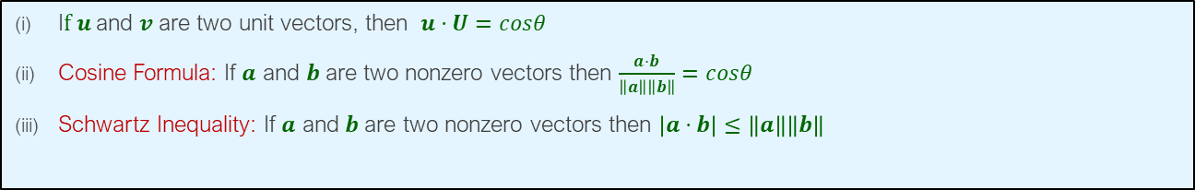
Angle between Two Vectors
I$f u$and $v$ are two unit vectors, then $u⋅U=cosθ$
Cosine Formula: If $a$ and $b$are two nonzero vectors then $\frac{a⋅b}{\left\|a\right\|\left\|b\right\|}=cosθ$
Schwartz Inequality: If $a$ and $b$are two nonzero vectors then $\left|a⋅b\right|≤\left\|a\right\|\left\|b\right\|$

Slide 7
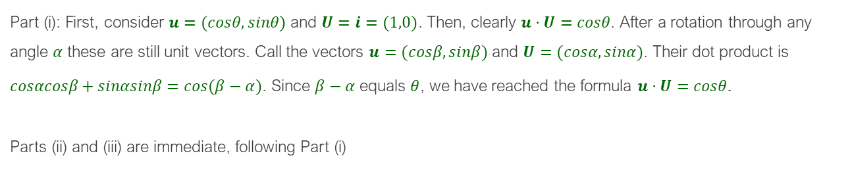
Angle between Two Vectors
Part (i): First, consider $u=(cosθ,sinθ)$ and $U=i=(1,0)$. Then, clearly $u⋅U=cosθ$. After a rotation through any angle $α$ these are still unit vectors. Call the vectors $u=(cosβ,sinβ)$ and $U=(cosα,sinα)$. Their dot product is
$cosαcosβ+sinαsinβ=cos(β−α)$. Since $β−α$ equals $θ$, we have reached the formula $u⋅U=cosθ$.
Parts (ii) and (iii) are immediate, following Part (i)

Slide 8
Other Properties of Matrices

Slide 9

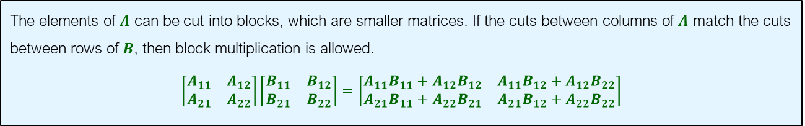
Matrix Multiplication
Block Matrices and Block Multiplication
The elements of $A$ can be cut into blocks, which are smaller matrices. If the cuts between columns of $A$ match the cuts between rows of $B$, then block multiplication is allowed.
$$\left[\begin{matrix}A_{11} & A_{12} \\ A_{21} & A_{22}\end{matrix}\right]\left[\begin{matrix}B_{11} & B_{12} \\ B_{21} & B_{22}\end{matrix}\right]=\left[\begin{matrix}A_{11}B_{11}+A_{12}B_{12} & A_{11}B_{12}+A_{12}B_{22} \\ A_{21}B_{11}+A_{22}B_{21} & A_{21}B_{12}+A_{22}B_{22}\end{matrix}\right]$$
Example:
$$\left[\begin{matrix}1 & 3 & 0 & 0 \\ 2 & 3 & 1 & 6 \\ −3 & −1 & 1 & 0 \\ 0 & 2 & 0 & 1\end{matrix}\right]\left[\begin{matrix}1 & 3 & 0 & 0 \\ 2 & 3 & 1 & 6 \\ −3 & −1 & 1 & 0 \\ 0 & 2 & 0 & 1\end{matrix}\right]=\left[\begin{matrix}7 & 12 & 3 & 16 \\ 5 & 26 & 4 & 24 \\ −8 & −13 & 0 & −6 \\ 4 & 8 & 2 & 13\end{matrix}\right]$$
$$\left[\begin{matrix}1 & 3 \\ 2 & 3\end{matrix}\right]\left[\begin{matrix}1 & 3 \\ 2 & 3\end{matrix}\right]+\left[\begin{matrix}0 & 0 \\ 1 & 6\end{matrix}\right]\left[\begin{matrix}−3 & −1 \\ 0 & 2\end{matrix}\right]=\left[\begin{matrix}7 & 12 \\ 5 & 26\end{matrix}\right]$$

Slide 10

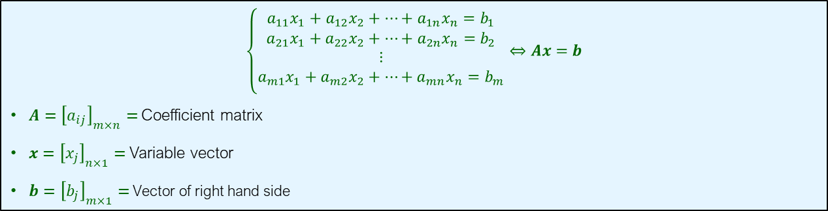
Linear Equations
$$\left\{\begin{matrix}\begin{aligned}a_{11}x_{1}+a_{12}x_{2}+…+a_{1n}x_{n}=b_{1} \\ a_{21}x_{1}+a_{22}x_{2}+…+a_{2n}x_{n}=b_{2} \\ ⋮ \\ a_{m1}x_{1}+a_{m2}x_{2}+…+a_{mn}x_{n}=b_{m}\end{aligned} \\ \end{matrix}\right.⇔Ax=b$$
$A={\left[a_{ij}\right]}_{m×n}=$ Coefficient matrix
$x={\left[x_{j}\right]}_{n×1}=$ Variable vector
$b={\left[b_{j}\right]}_{m×1}=$ Vector of right hand side
The product $Ax$ is the combination of columns of $A$. Hence, the system has solution if $b$ is inside the spanned space of the columns of $A$:
$$x_{1}\left[\begin{matrix}a_{11} \\ a_{21} \\ \begin{aligned}. \\ . \\ . \\ a_{m1}\end{aligned}\end{matrix}\right]+x_{2}\left[\begin{matrix}a_{12} \\ a_{22} \\ \begin{aligned}. \\ . \\ . \\ a_{m2}\end{aligned}\end{matrix}\right]+…+x_{n}\left[\begin{matrix}a_{1n} \\ a_{2n} \\ \begin{aligned}. \\ . \\ . \\ a_{mn}\end{aligned}\end{matrix}\right]=\left[\begin{matrix}b_{1} \\ b_{2} \\ \begin{aligned}. \\ . \\ . \\ b_{m}\end{aligned}\end{matrix}\right]$$

Slide 11
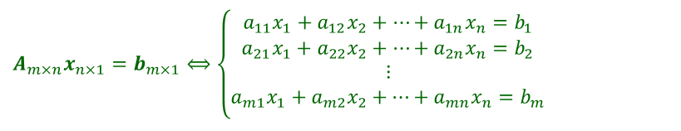
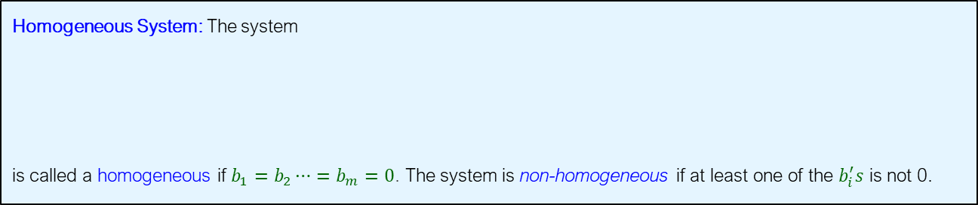
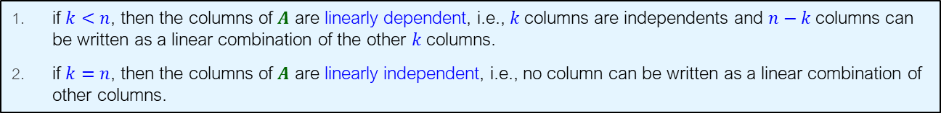
Homogeneous systems
Homogeneous System: The system
is called a homogeneous if $b_{1}=b_{2}⋯=b_{m}=0$. The system is non-homogeneous if at least one of the $b_{i}^{′}s$ is not 0.
$$A_{m×n}x_{n×1}=b_{m×1}⟺\left\{\begin{matrix}\begin{aligned}a_{11}x_{1}+a_{12}x_{2}+…+a_{1n}x_{n}=b_{1} \\ a_{21}x_{1}+a_{22}x_{2}+…+a_{2n}x_{n}=b_{2} \\ ⋮ \\ a_{m1}x_{1}+a_{m2}x_{2}+…+a_{mn}x_{n}=b_{m}\end{aligned} \\ \end{matrix}\right.$$
if $k<n$, then the columns of $A$ are linearly dependent, i.e., $k$columns are independents and $n−k$ columns can be written as a linear combination of the other $k$columns.
if $k=n$, then the columns of $A$ are linearly independent, i.e., no column can be written as a linear combination of other columns.

Slide 12
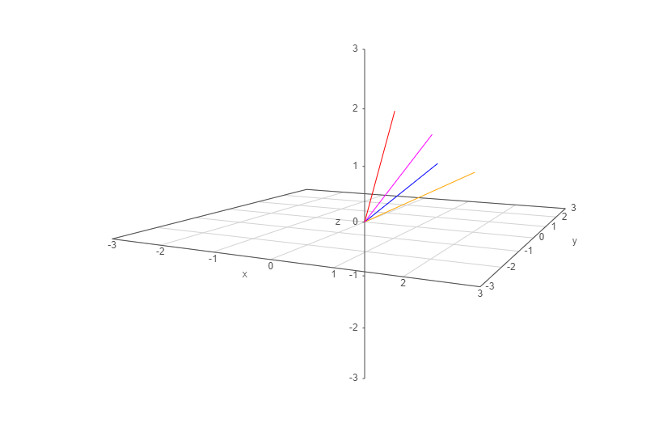

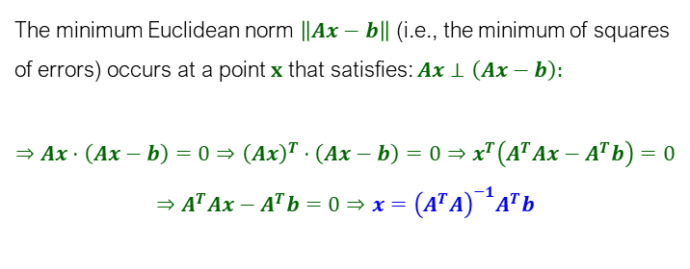
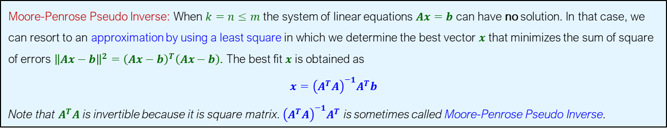
Moore-Penrose Pseudo Inverse
Moore-Penrose Pseudo Inverse: When $k=n≤m$ the system of linear equations $Ax=b$ can have no solution. In that case, we can resort to an approximation by using a least square in which we determine the best vector $x$ that minimizes the sum of square of errors ${\left\|Ax−b\right\|}^{2}={\left(Ax−b\right)}^{T}\left(Ax−b\right)$. The best fit $x$ is obtained as
$$x={\left(A^{T}A\right)}^{−1}A^{T}b$$
Note that $A^{T}A$ is invertible because it is square matrix. ${\left(A^{T}A\right)}^{−1}A^{T}$ is sometimes called Moore-Penrose Pseudo Inverse.
The minimum Euclidean norm $\left\|Ax−b\right\|$ (i.e., the minimum of squares of errors) occurs at a point $x$ that satisfies: $Ax⊥\left(Ax−b\right):$
$$⇒Ax⋅\left(Ax−b\right)=0⇒{\left(Ax\right)}^{T}⋅\left(Ax−b\right)=0⇒x^{T}\left(A^{T}Ax−A^{T}b\right)=0$$
$$⇒A^{T}Ax−A^{T}b=0⇒x={\left(A^{T}A\right)}^{−1}A^{T}b$$

Slide 13
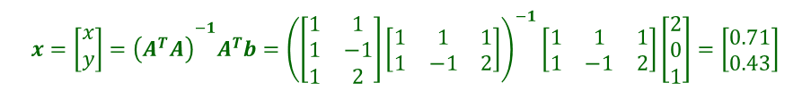



Example
Moore-Penrose Pseudo Inverse
Solve the system by finding the inverse of the coefficient matrix.
$$\left\{\begin{matrix}x+y=2 \\ x−y=0 \\ x+2y=1\end{matrix}\right.$$
$A=\left[\begin{matrix}1 & 1 \\ 1 & −1 \\ 1 & 2\end{matrix}\right],b=\left[\begin{matrix}2 \\ 0 \\ 1\end{matrix}\right]⇒\left[\begin{matrix}1 & 1 \\ 1 & −1 \\ 1 & 2\end{matrix}\right]\left[\begin{matrix}x \\ y\end{matrix}\right]=\left[\begin{matrix}2 \\ 0 \\ 1\end{matrix}\right]⇒$ $x\left[\begin{matrix}1 \\ 1 \\ 1\end{matrix}\right]+y\left[\begin{matrix}1 \\ −1 \\ 2\end{matrix}\right]=\left[\begin{matrix}2 \\ 0 \\ 1\end{matrix}\right]⇒$ no solution
$${x=\left[\begin{matrix}x \\ y\end{matrix}\right]=\left(A^{T}A\right)}^{−1}A^{T}b={\left(\left[\begin{matrix}1 & 1 \\ 1 & −1 \\ 1 & 2\end{matrix}\right]\left[\begin{matrix}1 & 1 & 1 \\ 1 & −1 & 2\end{matrix}\right]\right)}^{−1}\left[\begin{matrix}1 & 1 & 1 \\ 1 & −1 & 2\end{matrix}\right]\left[\begin{matrix}2 \\ 0 \\ 1\end{matrix}\right]=\left[\begin{matrix}0.71 \\ 0.43\end{matrix}\right]$$
$$Ax=\left[\begin{matrix}1 & 1 \\ 1 & −1 \\ 1 & 2\end{matrix}\right]\left[\begin{matrix}x \\ y\end{matrix}\right]=x\left[\begin{matrix}1 \\ 1 \\ 1\end{matrix}\right]+y\left[\begin{matrix}1 \\ −1 \\ 2\end{matrix}\right]=\left[\begin{matrix}1.14 \\ 0.29 \\ 1.57\end{matrix}\right]$$

Slide 14







Example
Moore-Penrose Pseudo Inverse
library(pracma)
A=matrix(c(1,1,1,-1,1,2),3,2,1)
b=matrix(c(2,0,1),3,1)
x=solve(t(A)%*%A)%*%t(A)%*%b
Norm(A%*%x-b)
f= function(x) {
y=Norm(A%*%x-b);
return(y);
}
optim(x,f)
$par
[,1]
[1,] 0.7142857
[2,] 0.4285714
$value
[1] 1.069045

Slide 15













Slide 16
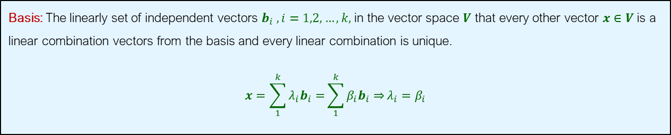
Basis of a Vector Space
Basis: The linearly set of independent vectors $b_{i} ,i=1,2,…,k,$in the vector space $V$ that every other vector $x∈V$ is a linear combination vectors from the basis and every linear combination is unique.
$$x=\sum_{1}^{k}{{λ_{i}b}_{i}=}\sum_{1}^{k}{{β_{i}b}_{i}⇒}λ_{i}=β_{i}$$

Slide 17
Determinants

Slide 18
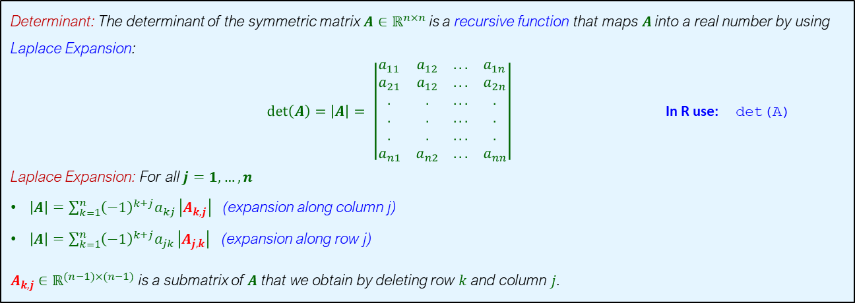
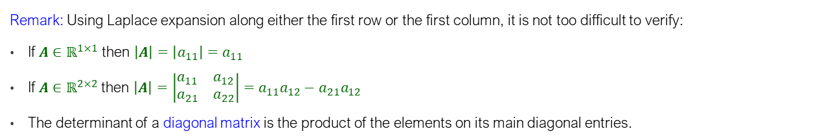
Determinants
Determinant: The determinant of the symmetric matrix $A∈ℝ^{n×n}$is a recursive function that maps $A$into a real number by using Laplace Expansion:
$det\left(A\right)=\left|A\right|= \left|\begin{matrix}a_{11} & a_{12} & ... & a_{1n} \\ a_{21} & a_{12} & ... & a_{2n} \\ . & . & ... & . \\ . & . & ... & . \\ . & . & ... & . \\ a_{n1} & a_{n2} & ... & a_{nn}\end{matrix}\right|$ In R use: det(A)
Laplace Expansion: For all $j=1,…,n$
$\left|A\right|=\sum_{k=1}^{n}{{\left(−1\right)}^{k+j}a_{kj}}\left|A_{k,j}\right|$ (expansion along column j)
$\left|A\right|=\sum_{k=1}^{n}{{\left(−1\right)}^{k+j}a_{jk}}\left|A_{j,k}\right|$ (expansion along row j)
$A_{k,j}∈ℝ^{(n−1)×(n−1)}$ is a submatrix of $A$ that we obtain by deleting row $k$ and column $j$.
Remark: Using Laplace expansion along either the first row or the first column, it is not too difficult to verify:
If $A∈ℝ^{1×1}$ then $\left|A\right|=\left|a_{11}\right|=a_{11}$
If $A∈ℝ^{2×2}$then $\left|A\right|=\left|\begin{matrix}a_{11} & a_{12} \\ a_{21} & a_{22}\end{matrix}\right|=a_{11}a_{12}−a_{21}a_{12}$
The determinant of a diagonal matrix is the product of the elements on its main diagonal entries.

Slide 19
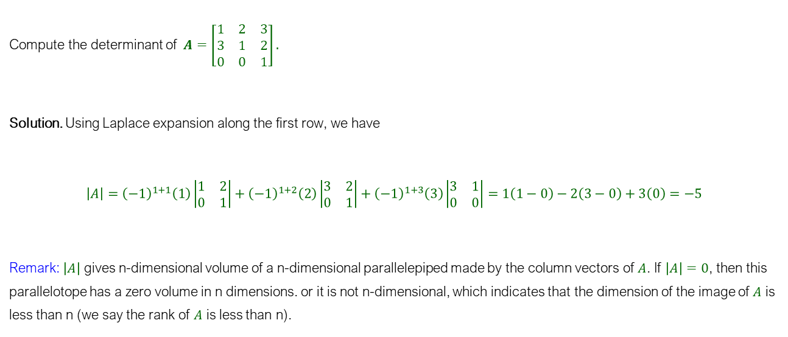
Determinants
Example
Compute the determinant of $A=\left[\begin{matrix}1 & 2 & 3 \\ 3 & 1 & 2 \\ 0 & 0 & 1\end{matrix}\right].$
Solution. Using Laplace expansion along the first row, we have
$$\left|A\right|={\left(−1\right)}^{1+1}\left(1\right)\left|\begin{matrix}1 & 2 \\ 0 & 1\end{matrix}\right|+{\left(−1\right)}^{1+2}\left(2\right)\left|\begin{matrix}3 & 2 \\ 0 & 1\end{matrix}\right|+{\left(−1\right)}^{1+3}\left(3\right)\left|\begin{matrix}3 & 1 \\ 0 & 0\end{matrix}\right|=1\left(1−0\right)−2\left(3−0\right)+3\left(0\right)=−5$$
Remark: $\left|A\right|$ gives n-dimensional volume of a n-dimensional parallelepiped made by the column vectors of $A$. If $\left|A\right|=0$, then this parallelotope has a zero volume in n dimensions. or it is not n-dimensional, which indicates that the dimension of the image of $A$ is less than n (we say the rank of $A$ is less than n).

Slide 20
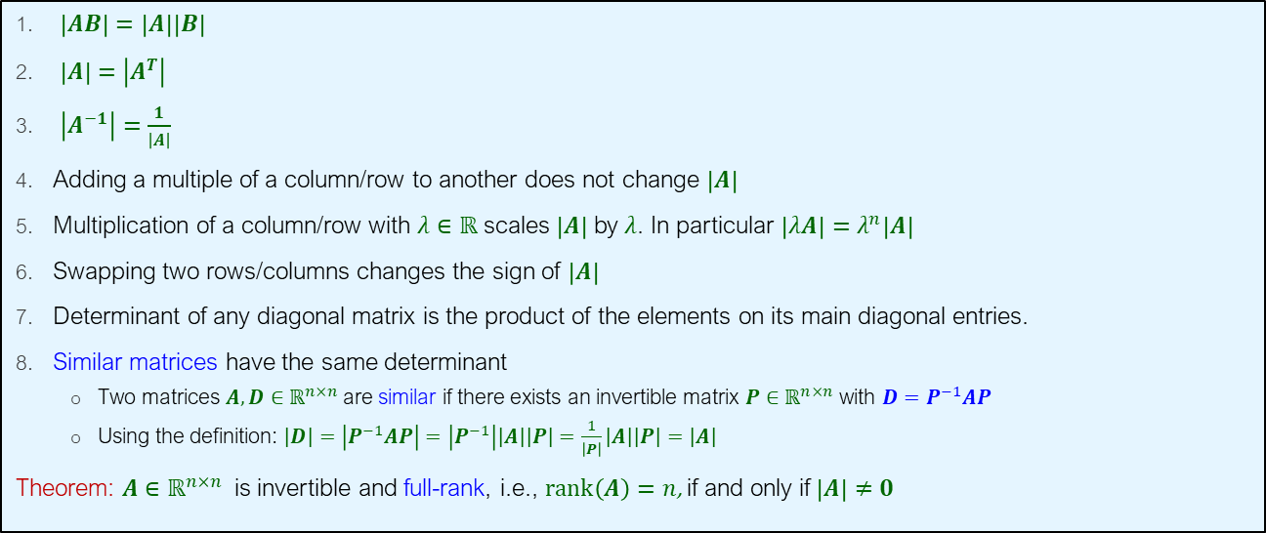
Determinants
Properties of Determinant
$\left|AB\right|=\left|A\right|\left|B\right|$
$\left|A\right|=$ $\left|A^{T}\right|$
$\left|A^{−1}\right|=\frac{1}{\left|A\right|}$
Adding a multiple of a column/row to another does not change $\left|A\right|$
Multiplication of a column/row with $λ∈ℝ$ scales $\left|A\right|$ by $λ$. In particular $\left|λA\right|=λ^{n}\left|A\right|$
Swapping two rows/columns changes the sign of $\left|A\right|$
Determinant of any diagonal matrix is the product of the elements on its main diagonal entries.
Similar matrices have the same determinant
Two matrices $A,D∈ℝ^{n×n}$are similar if there exists an invertible matrix $P∈ℝ^{n×n}$ with $D=P^{−1}AP$
Using the definition: $\left|D\right|=\left|P^{−1}AP\right|=\left|P^{−1}\right|\left|A\right|\left|P\right|=\frac{1}{\left|P\right|}\left|A\right|\left|P\right|=\left|A\right|$
Theorem: $A∈ℝ^{n×n}$ is invertible and full-rank, i.e., $rank\left(A\right)=n$, if and only if $\left|A\right|≠0$

Slide 21
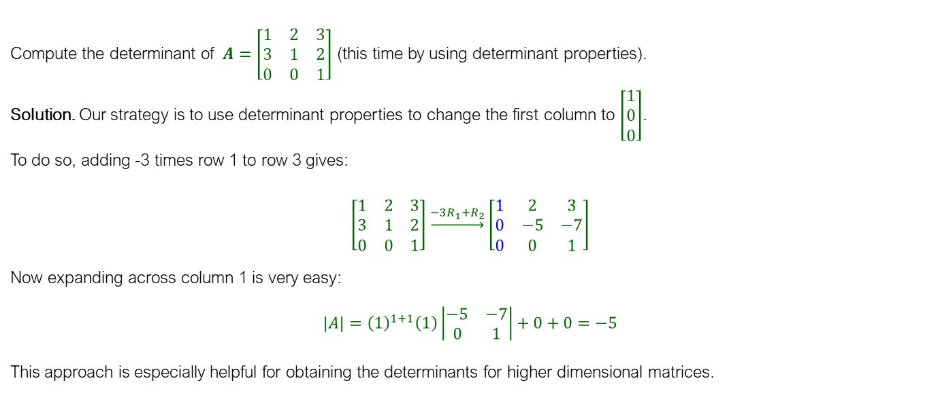
Determinants
Example
Compute the determinant of $A=\left[\begin{matrix}1 & 2 & 3 \\ 3 & 1 & 2 \\ 0 & 0 & 1\end{matrix}\right]$ (this time by using determinant properties).
Solution. Our strategy is to use determinant properties to change the first column to $\left[\begin{aligned}1 \\ 0 \\ 0\end{aligned}\right]$.
To do so, adding -3 times row 1 to row 3 gives:
$$\left[\begin{matrix}1 & 2 & 3 \\ 3 & 1 & 2 \\ 0 & 0 & 1\end{matrix}\right]\underset{→}{−3R_{1}+R_{2}}\left[\begin{matrix}1 & 2 & 3 \\ 0 & −5 & −7 \\ 0 & 0 & 1\end{matrix}\right]$$
Now expanding across column 1 is very easy:
$$\left|A\right|={\left(1\right)}^{1+1}\left(1\right)\left|\begin{matrix}−5 & −7 \\ 0 & 1\end{matrix}\right|+0+0=−5$$
This approach is especially helpful for obtaining the determinants for higher dimensional matrices.

Slide 22
Eigenvalues and Eigenvectors

Slide 23
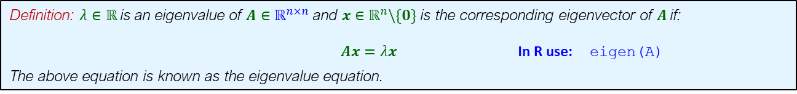
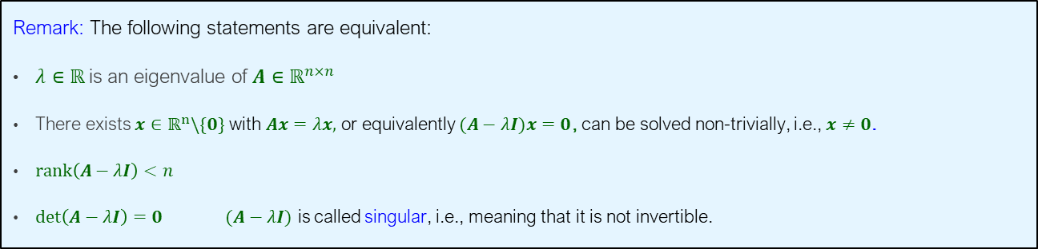
Eigenvalues and Eigenvectors
Definition: $λ∈ℝ$is an eigenvalue of $A∈ℝ^{n×n}$and $x∈ℝ^{n}\backslash \{0\}$ is the corresponding eigenvector of $A$if:
$Ax=λx$ In R use: eigen(A)
The above equation is known as the eigenvalue equation.
Remark: The following statements are equivalent:
$λ∈ℝ$is an eigenvalue of $A∈ℝ^{n×n}$
There exists $x∈ℝ^{n}\backslash \{0\}$ with $Ax=λx,$ or equivalently $(A−λI)x=0$, can be solved non-trivially, i.e., $x≠0$.
$rank\left(A−λI\right)<n$
$det\left(A−λI\right)=0$ $(A−λI)$ is called singular, i.e., meaning that it is not invertible.
Remark: $p_{A}\left(λ\right)≡det\left(A−λI\right)$ is also known as the Characteristic Polynomial

Slide 24
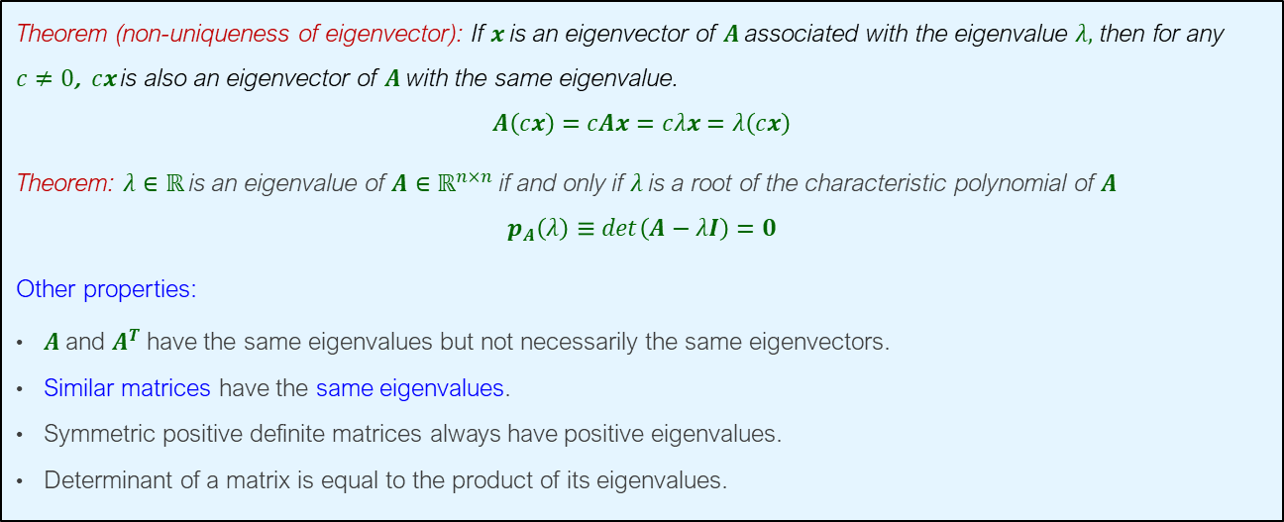
Eigenvalues and Eigenvectors
Properties of Eigenvalues and Eigenvectors
Theorem (non-uniqueness of eigenvector): If $x$ is an eigenvector of $A$associated with the eigenvalue $λ,$ then for any $c≠0$, $cx$ is also an eigenvector of $A$with the same eigenvalue.
$$A\left(cx\right)=cAx=cλx=λ\left(cx\right)$$
Theorem: $λ∈ℝ$is an eigenvalue of $A∈ℝ^{n×n}$ if and only if $λ$ is a root of the characteristic polynomial of $A$
$$p_{A}\left(λ\right)≡det\left(A−λI\right)=0$$
Other properties:
$A$ and $A^{T}$ have the same eigenvalues but not necessarily the same eigenvectors.
Similar matrices have the same eigenvalues.
Symmetric positive definite matrices always have positive eigenvalues.
Determinant of a matrix is equal to the product of its eigenvalues.

Slide 25
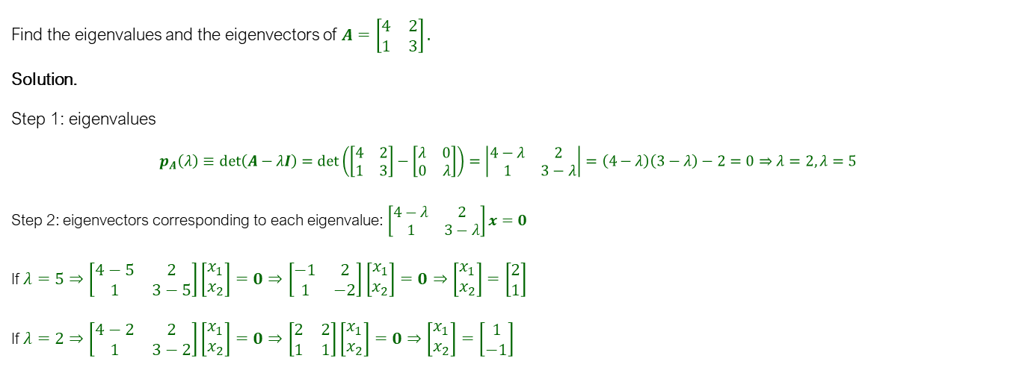
Eigenvalues and Eigenvectors
Example
Find the eigenvalues and the eigenvectors of $A=\left[\begin{matrix}4 & 2 \\ 1 & 3\end{matrix}\right].$
Solution.
Step 1: eigenvalues
$$p_{A}\left(λ\right)≡det\left(A−λI\right)=det\left(\left[\begin{matrix}4 & 2 \\ 1 & 3\end{matrix}\right]−\left[\begin{matrix}λ & 0 \\ 0 & λ\end{matrix}\right]\right)=\left|\begin{matrix}4−λ & 2 \\ 1 & 3−λ\end{matrix}\right|=\left(4−λ\right)\left(3−λ\right)−2=0⇒λ=2, λ=5$$
Step 2: eigenvectors corresponding to each eigenvalue: $\left[\begin{matrix}4−λ & 2 \\ 1 & 3−λ\end{matrix}\right]x=0$
If $λ=5⇒\left[\begin{matrix}4−5 & 2 \\ 1 & 3−5\end{matrix}\right]\left[\begin{aligned}x_{1} \\ x_{2}\end{aligned}\right]=0⇒\left[\begin{matrix}−1 & 2 \\ 1 & −2\end{matrix}\right]\left[\begin{aligned}x_{1} \\ x_{2}\end{aligned}\right]=0⇒\left[\begin{aligned}x_{1} \\ x_{2}\end{aligned}\right]=\left[\begin{aligned}2 \\ 1\end{aligned}\right]$
If $λ=2⇒\left[\begin{matrix}4−2 & 2 \\ 1 & 3−2\end{matrix}\right]\left[\begin{aligned}x_{1} \\ x_{2}\end{aligned}\right]=0⇒\left[\begin{matrix}2 & 2 \\ 1 & 1\end{matrix}\right]\left[\begin{aligned}x_{1} \\ x_{2}\end{aligned}\right]=0⇒\left[\begin{aligned}x_{1} \\ x_{2}\end{aligned}\right]=\left[\begin{aligned}1 \\ −1\end{aligned}\right]$

Slide 26

Matrix Decomposition (Important tool for obtaining complex computations, e.g., $\sqrt{A}$, $A^{−3.456}, e^{A},$ and many other results)

Slide 27
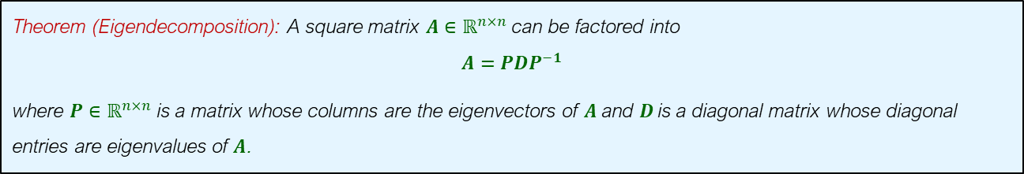
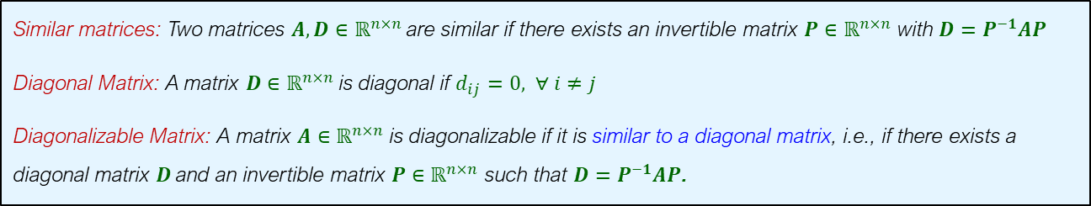
Matrix Decomposition
Eigendecomposition and Diagonalization
Similar matrices: Two matrices $A,D∈ℝ^{n×n}$are similar if there exists an invertible matrix $P∈ℝ^{n×n}$ with $D=P^{−1}AP$
Diagonal Matrix: A matrix $D∈ℝ^{n×n}$ is diagonal if $d_{ij}=0, ∀ i≠j$
Diagonalizable Matrix: A matrix $A∈ℝ^{n×n}$ is diagonalizable if it is similar to a diagonal matrix, i.e., if there exists a diagonal matrix $D$and an invertible matrix $P∈ℝ^{n×n}$ such that $D=P^{−1}AP$.
Theorem (Eigendecomposition): A square matrix $A∈ℝ^{n×n}$ can be factored into
$$A={PDP}^{−1}$$
where $P∈ℝ^{n×n}$ is a matrix whose columns are the eigenvectors of $A$ and $D$is a diagonal matrix whose diagonal entries are eigenvalues of $A$.

Slide 28
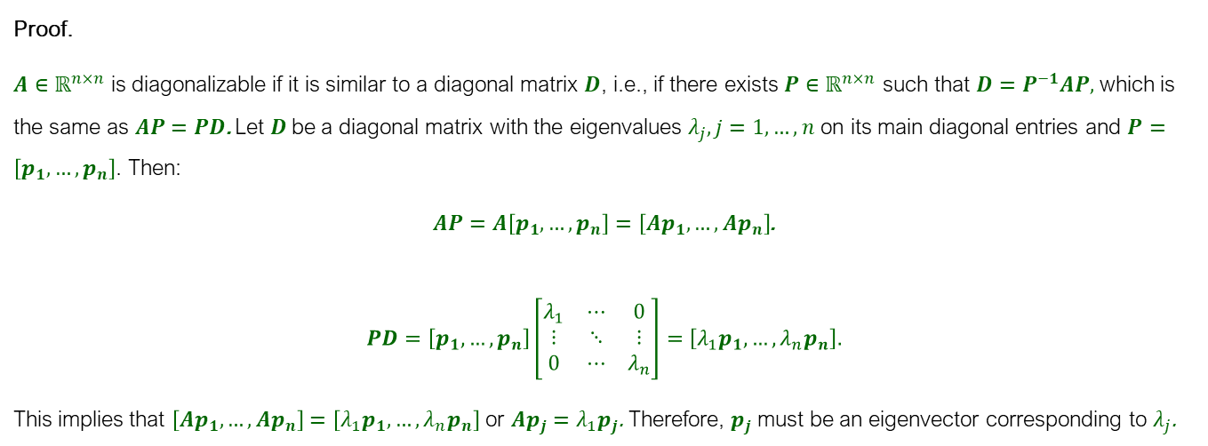
Matrix Decomposition
Eigendecomposition
Proof.
$A∈ℝ^{n×n}$ is diagonalizable if it is similar to a diagonal matrix $D$, i.e., if there exists $P∈ℝ^{n×n}$ such that $D=P^{−1}AP,$ which is the same as $AP=PD$. Let $D$be a diagonal matrix with the eigenvalues $λ_{j}, j=1,…,n$ on its main diagonal entries and $P=\left[p_{1},…,p_{n}\right]$. Then:
$AP=A\left[p_{1},…,p_{n}\right]=\left[Ap_{1},…,Ap_{n}\right]$.
$$PD=\left[p_{1},…,p_{n}\right]\left[\begin{matrix}λ_{1} & ⋯ & 0 \\ ⋮ & ⋱ & ⋮ \\ 0 & ⋯ & λ_{n}\end{matrix}\right]=\left[λ_{1}p_{1},…,{λ_{n}p}_{n}\right].$$
This implies that $\left[Ap_{1},…,Ap_{n}\right]=\left[λ_{1}p_{1},…,{λ_{n}p}_{n}\right]$ or $Ap_{j}=λ_{1}p_{j}$. Therefore, $p_{j}$ must be an eigenvector corresponding to $λ_{j}$.

Slide 29
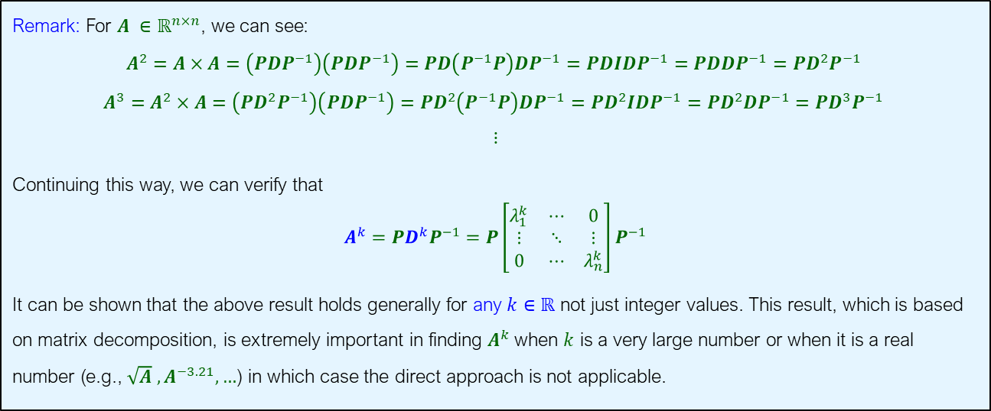
Matrix Decomposition
Real Powers of a Matrix
Remark: For $A ∈ℝ^{n×n}$, we can see:
$$A^{2}=A×A=\left({PDP}^{−1}\right)\left({PDP}^{−1}\right)=PD\left(P^{−1}P\right)DP^{−1}=PDIDP^{−1}=PDDP^{−1}=PD^{2}P^{−1}$$
$$A^{3}=A^{2}×A=\left({PD^{2}P}^{−1}\right)\left({PDP}^{−1}\right)=PD^{2}\left(P^{−1}P\right)DP^{−1}=PD^{2}IDP^{−1}=PD^{2}DP^{−1}=PD^{3}P^{−1}$$
$$⋮$$
Continuing this way, we can verify that
$$A^{k}={PD^{k}P}^{−1}={P\left[\begin{matrix}λ_{1}^{k} & ⋯ & 0 \\ ⋮ & ⋱ & ⋮ \\ 0 & ⋯ & λ_{n}^{k}\end{matrix}\right]P}^{−1}$$
It can be shown that the above result holds generally for any $k∈ℝ$ not just integer values. This result, which is based on matrix decomposition, is extremely important in finding $A^{k}$ when $k$ is a very large number or when it is a real number (e.g., $\sqrt{A} ,A^{−3.21},…$) in which case the direct approach is not applicable.

Slide 30
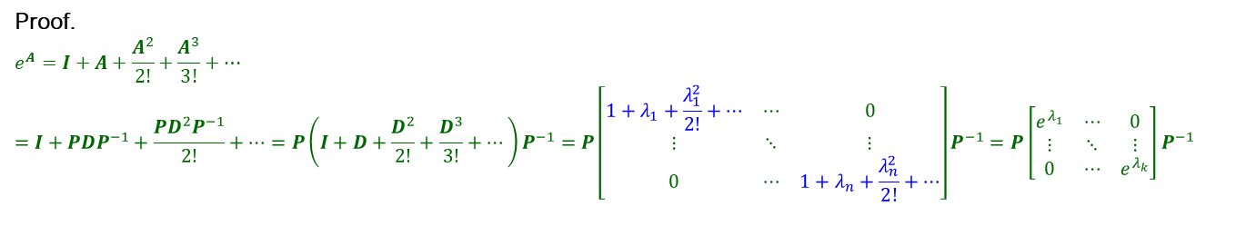
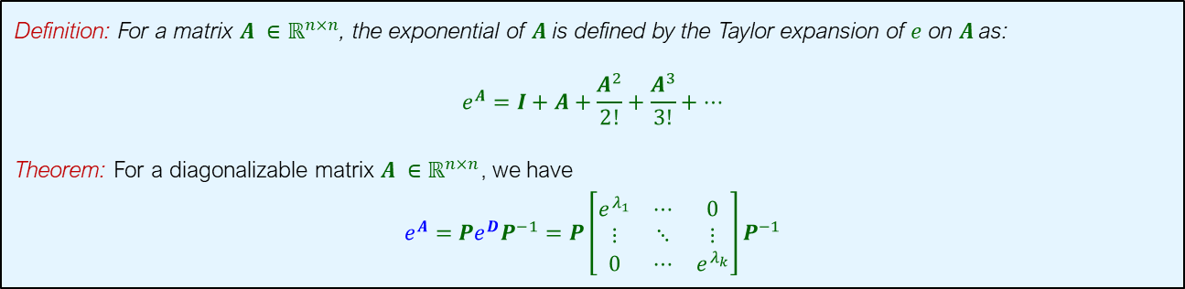
Matrix Decomposition
Exponential and Logarithm of a Matrix
Definition: For a matrix $A ∈ℝ^{n×n}$, the exponential of $A$ is defined by the Taylor expansion of $e$ on $A$as:
$$e^{A}=I+A+\frac{A^{2}}{2!}+\frac{A^{3}}{3!}+…$$
Theorem: For a diagonalizable matrix $A ∈ℝ^{n×n}$, we have
$$e^{A}=Pe^{D}P^{−1}={P\left[\begin{matrix}e^{λ_{1}} & ⋯ & 0 \\ ⋮ & ⋱ & ⋮ \\ 0 & ⋯ & e^{λ_{k}}\end{matrix}\right]P}^{−1}$$
Proof.
$$e^{A}=I+A+\frac{A^{2}}{2!}+\frac{A^{3}}{3!}+…$$
$$=I+{PDP}^{−1}+\frac{{PD^{2}P}^{−1}}{2!}+…=P\left(I+D+\frac{D^{2}}{2!}+\frac{D^{3}}{3!}+…\right)P^{−1}={P\left[\begin{matrix}1+λ_{1}+\frac{λ_{1}^{2}}{2!}+… & ⋯ & 0 \\ ⋮ & ⋱ & ⋮ \\ 0 & ⋯ & 1+λ_{n}+\frac{λ_{n}^{2}}{2!}+…\end{matrix}\right]P}^{−1}={P\left[\begin{matrix}e^{λ_{1}} & ⋯ & 0 \\ ⋮ & ⋱ & ⋮ \\ 0 & ⋯ & e^{λ_{k}}\end{matrix}\right]P}^{−1}$$

Slide 31
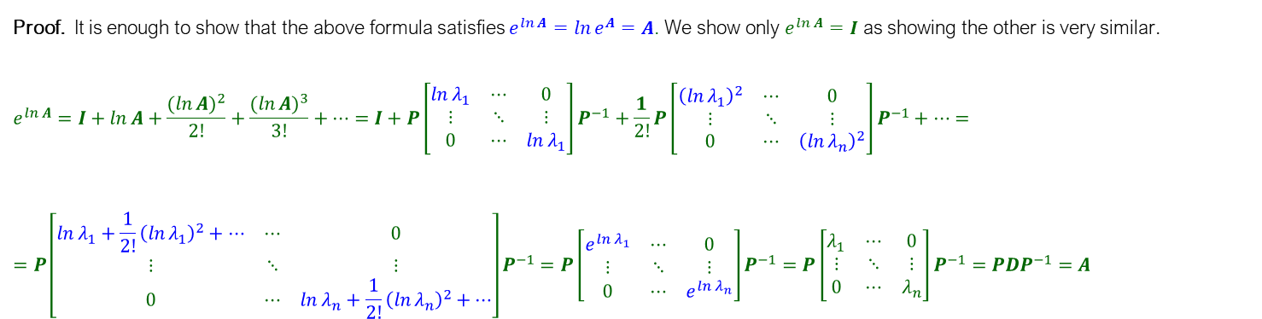
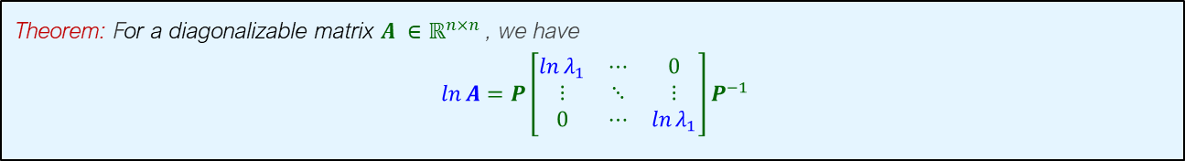
Matrix Decomposition
Exponential and Logarithm of a Matrix
Theorem: For a diagonalizable matrix $A ∈ℝ^{n×n}$ , we have
$$\ln{A}=P\left[\begin{matrix}\ln{λ_{1}} & ⋯ & 0 \\ ⋮ & ⋱ & ⋮ \\ 0 & ⋯ & \ln{λ_{1}}\end{matrix}\right]P^{−1}$$
Proof. It is enough to show that the above formula satisfies $e^{\ln{A}}=\ln{e^{A}}=A$. We show only $e^{\ln{A}}=I$ as showing the other is very similar.
$$e^{\ln{A}}=I+\ln{A}+\frac{{(\ln{A})}^{2}}{2!}+\frac{{(\ln{A})}^{3}}{3!}+…=I+{P\left[\begin{matrix}\ln{λ_{1}} & ⋯ & 0 \\ ⋮ & ⋱ & ⋮ \\ 0 & ⋯ & \ln{λ_{1}}\end{matrix}\right]P}^{−1}+\frac{1}{2!}{P\left[\begin{matrix}{\left(\ln{λ_{1}}\right)}^{2} & ⋯ & 0 \\ ⋮ & ⋱ & ⋮ \\ 0 & ⋯ & {\left(\ln{λ_{n}}\right)}^{2}\end{matrix}\right]P}^{−1}+…==P\left[\begin{matrix}\ln{λ_{1}+\frac{1}{2!}}{\left(\ln{λ_{1}}\right)}^{2}+… & ⋯ & 0 \\ ⋮ & ⋱ & ⋮ \\ 0 & ⋯ & \ln{λ_{n}+\frac{1}{2!}}{\left(\ln{λ_{n}}\right)}^{2}+…\end{matrix}\right]P^{−1}=P\left[\begin{matrix}e^{\ln{λ_{1}}} & ⋯ & 0 \\ ⋮ & ⋱ & ⋮ \\ 0 & ⋯ & e^{\ln{λ_{n}}}\end{matrix}\right]P^{−1}=P\left[\begin{matrix}λ_{1} & ⋯ & 0 \\ ⋮ & ⋱ & ⋮ \\ 0 & ⋯ & λ_{n}\end{matrix}\right]P^{−1}=PDP^{−1}=A$$

Slide 32
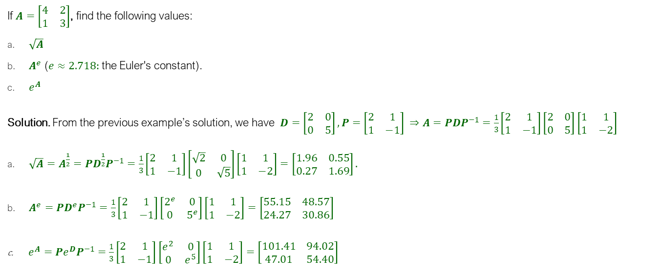
Matrix Decomposition
Example
If $A=\left[\begin{matrix}4 & 2 \\ 1 & 3\end{matrix}\right]$, find the following values:
$\sqrt{A}$
$A^{e}$ ($e≈2.718:$ the Euler's constant).
$e^{A}$
Solution. From the previous example’s solution, we have $D=\left[\begin{matrix}2 & 0 \\ 0 & 5\end{matrix}\right],P=\left[\begin{matrix}2 & 1 \\ 1 & −1\end{matrix}\right] ⇒A={PDP}^{−1}=\frac{1}{3}\left[\begin{matrix}2 & 1 \\ 1 & −1\end{matrix}\right]\left[\begin{matrix}2 & 0 \\ 0 & 5\end{matrix}\right]\left[\begin{matrix}1 & 1 \\ 1 & −2\end{matrix}\right]$
${\sqrt{A}=A}^{\frac{1}{2}}={PD^{\frac{1}{2}}P}^{−1}=\frac{1}{3}\left[\begin{matrix}2 & 1 \\ 1 & −1\end{matrix}\right]\left[\begin{matrix}\sqrt{2} & 0 \\ 0 & \sqrt{5}\end{matrix}\right]\left[\begin{matrix}1 & 1 \\ 1 & −2\end{matrix}\right]=\left[\begin{matrix}1.96 & 0.55 \\ 0.27 & 1.69\end{matrix}\right].$
$A^{e}={PD^{e}P}^{−1}=\frac{1}{3}\left[\begin{matrix}2 & 1 \\ 1 & −1\end{matrix}\right]\left[\begin{matrix}2^{e} & 0 \\ 0 & 5^{e}\end{matrix}\right]\left[\begin{matrix}1 & 1 \\ 1 & −2\end{matrix}\right]=\left[\begin{matrix}55.15 & 48.57 \\ 24.27 & 30.86\end{matrix}\right]$
$e^{A}=Pe^{D}P^{−1}=\frac{1}{3}\left[\begin{matrix}2 & 1 \\ 1 & −1\end{matrix}\right]\left[\begin{matrix}e^{2} & 0 \\ 0 & e^{5}\end{matrix}\right]\left[\begin{matrix}1 & 1 \\ 1 & −2\end{matrix}\right]=\left[\begin{matrix}101.41 & 94.02 \\ 47.01 & 54.40\end{matrix}\right]$
y$vectors%*%diag(exp(y$values))%*%matrix.inverse(y$vectors)

Slide 33
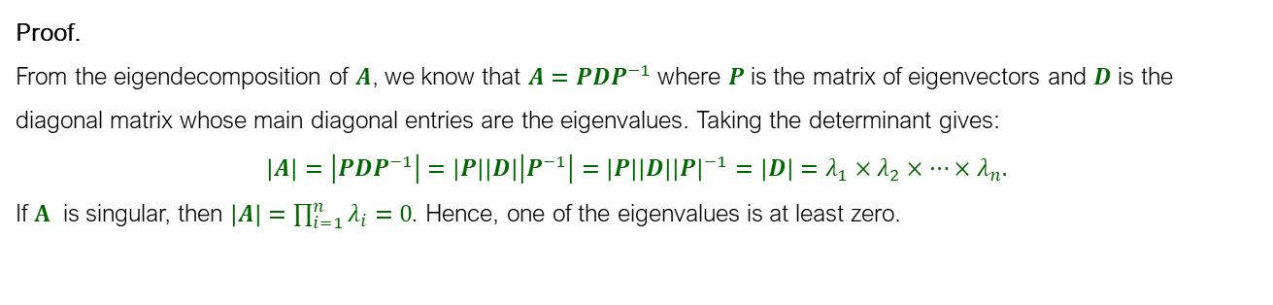
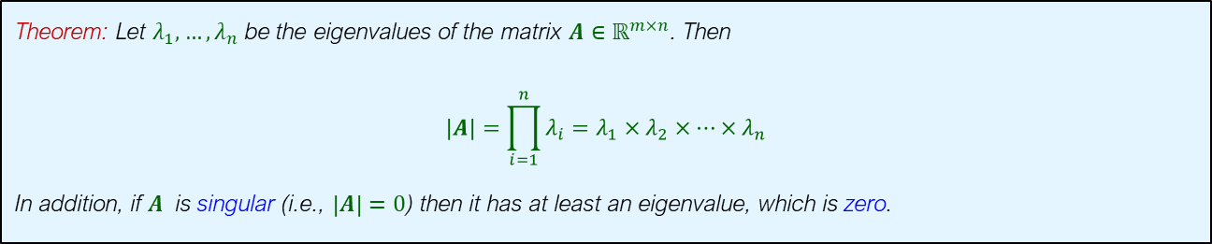
Matrix Decomposition
Relationship between Eigenvalues and Determinant
Theorem: Let $λ_{1},…,λ_{n}$ be the eigenvalues of the matrix $A∈ℝ^{m×n}$. Then
$$\left|A\right|={\prod_{i=1}^{n}{λ_{i}}=λ}_{1}×λ_{2}×…×λ_{n}$$
In addition, if $A$ is singular (i.e., $\left|A\right|=0$) then it has at least an eigenvalue, which is zero.
Proof.
From the eigendecomposition of $A$, we know that ${A=PDP}^{−1}$ where $P$ is the matrix of eigenvectors and $D$ is the diagonal matrix whose main diagonal entries are the eigenvalues. Taking the determinant gives:
$$\left|A\right|=\left|{PDP}^{−1}\right|=\left|P\right|\left|D\right|\left|P^{−1}\right|=\left|P\right|\left|D\right|{\left|P\right|}^{−1}=\left|D\right|=λ_{1}×λ_{2}×…×λ_{n}.$$
If $A$ is singular, then $\left|A\right|=\prod_{i=1}^{n}{λ_{i}}=0$. Hence, one of the eigenvalues is at least zero.

Slide 34
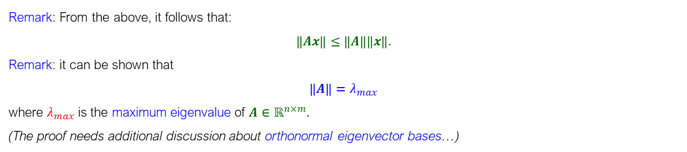

Matrix Norms
Norm of a matrix: The definition of the corresponding norm for an $n×n$matrix $A∈ℝ^{n×m}$ is
$$\left\|A\right\|=\max_{x≠0}{\frac{\left\|Ax\right\|}{\left\|x\right\|}=\max_{\left\|x\right\|=1} \left\|Ax\right\| ∀x∈ℝ^{n}}.$$
Where $\left\|⋅\right\|$ is the Euclidean norm.
Remark: From the above, it follows that:
$$\left\|Ax\right\|≤\left\|A\right\|\left\|x\right\|.$$
Remark: it can be shown that
${\left\|A\right\|=λ}_{max}$
where $λ_{max}$is the maximum eigenvalue of $A∈ℝ^{n×m}.$
(The proof needs additional discussion about orthonormal eigenvector bases…)

Slide 35


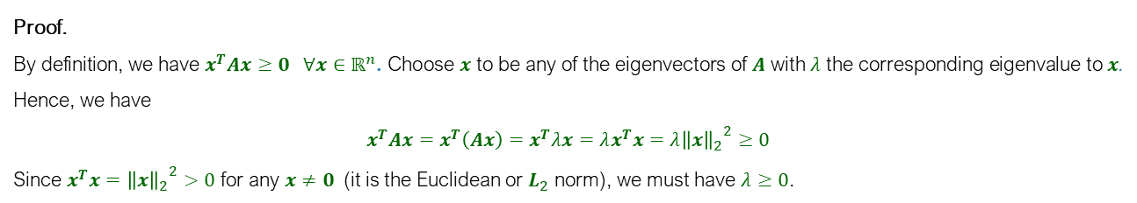
Positive Definite Matrices
Definition: a symmetric $A∈ℝ^{n×n}$ is called positive semidefinite if and only if
$$x^{T}Ax≥0 ∀x∈ℝ^{n}$$
And positive definite if and only if
$$x^{T}Ax>0 ∀x≠0∈ℝ^{n}$$
Theorem: $A∈ℝ^{n×n}$ is positive semidefinite if and only if all its eigenvalues are greater than or equal to zero.
Proof.
By definition, we have $x^{T}Ax≥0 ∀x∈ℝ^{n}$. Choose $x$ to be any of the eigenvectors of $A$ with $λ$ the corresponding eigenvalue to $x$. Hence, we have
$$x^{T}Ax=x^{T}\left(Ax\right)=x^{T}λx=λx^{T}x=λ{{\left\|x\right\|}_{2}}^{2}≥0$$
Since $x^{T}x={{\left\|x\right\|}_{2}}^{2}>0$ for any $x≠0$ (it is the Euclidean or $L_{2}$ norm), we must have $λ≥0$.
Remark: From above, it follows that if $A∈ℝ^{n×n}$ is positive semidefinite then $\left|A\right|≥0$ because $\left|A\right|=\prod_{i=1}^{n}{λ_{i}}$.

Slide 36

Positive Definite Matrices
Theorem: For a matrix $A∈ℝ^{m×n}$ we can always obtain a symmetric positive semidefinite matrix $S∈ℝ^{n×n}$ by defining
$$S=A^{T}A.$$
Proof.
Symmetry requires that $S=S^{T}$. We have $S^{T}={\left(A^{T}A\right)}^{T}=A^{T}{\left(A^{T}\right)}^{T}=A^{T}A.$
By definition, a PSD matrix, we have $x^{T}Sx=x^{T}A^{T}Ax={\left(xA\right)}^{T}\left(xA\right)={{\left\|xA\right\|}_{2}}^{2}≥0$.

